Slide 1

Soliton Infrastructure Tools on TestStand

Slide 2
Common Needs Across Teams
DUT Type
Validation Activity
Common Needs
PMICs
Data Converters
RFICs
Processors
etc
PVT Characterization
Accommodate Instrumentation across multiple test benches/product teams
Run test sequence across multiple test conditions (Temperature, Voltage Sweeps, etc)
Log Test Sequence Results
Report Generation in custom format
Firmware Validation
System Validation
Standards Compliance Testing

Slide 3
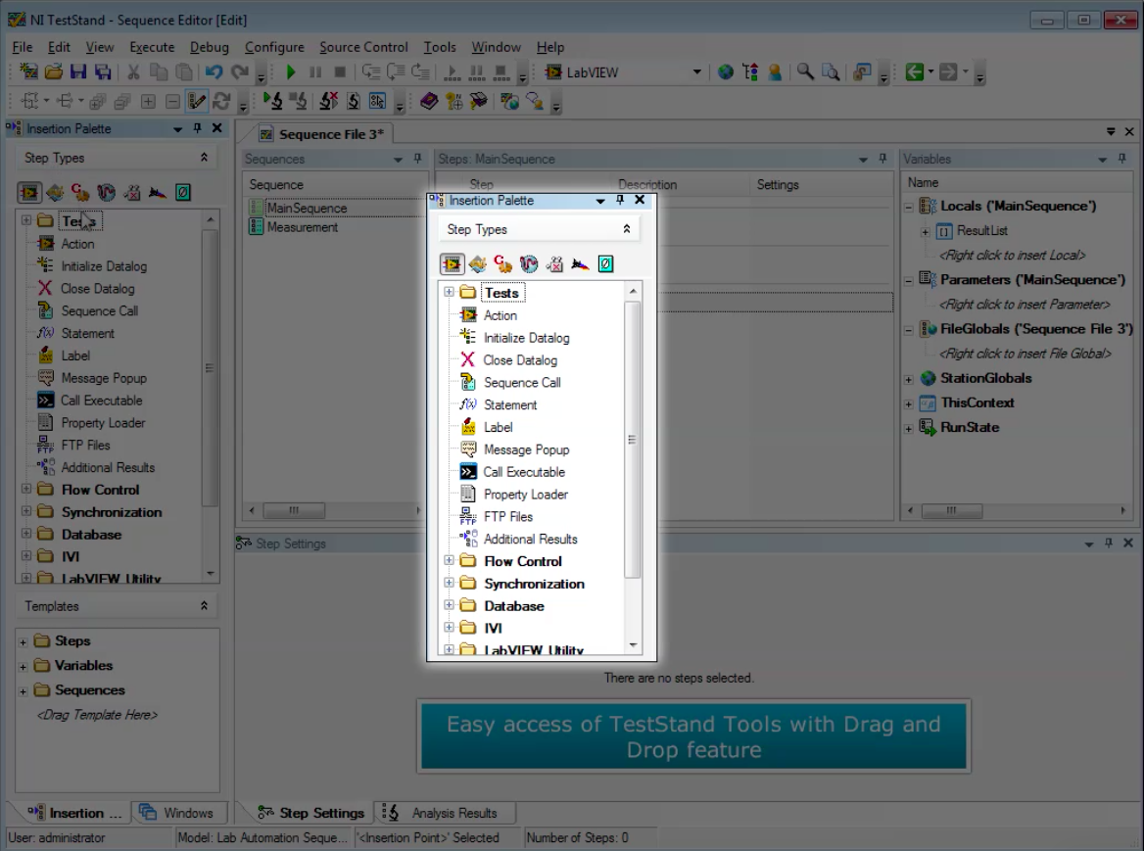
Soliton Infrastructure Tools
(LabVIEW & TestStand)
Soliton helps develop automation software infrastructure capable of reuse across multiple product teams for varied validation needs. In this presentation, we have provided an overview of a few tools developed in NI TestStand
Tools developed using LabVIEW & TestStand
Highly customized TestStand environment
Helps reduce entry barrier to automation using TestStand for new NI Software users
Generic build to enable use across multiple teams and use cases

Slide 4
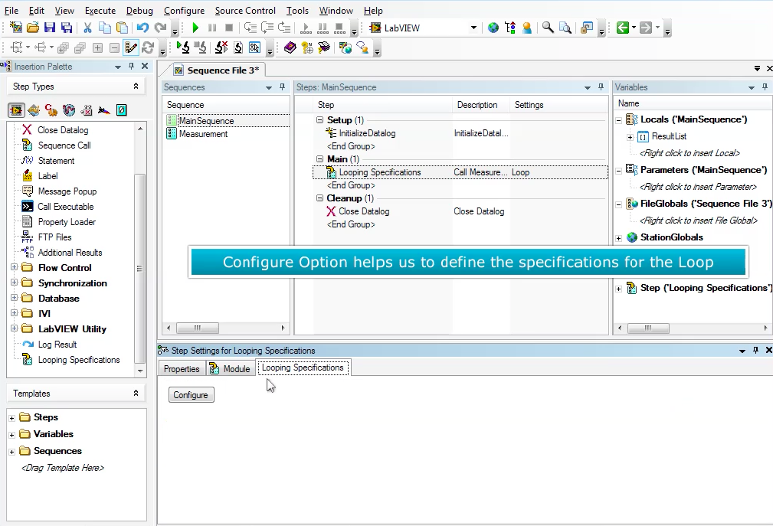
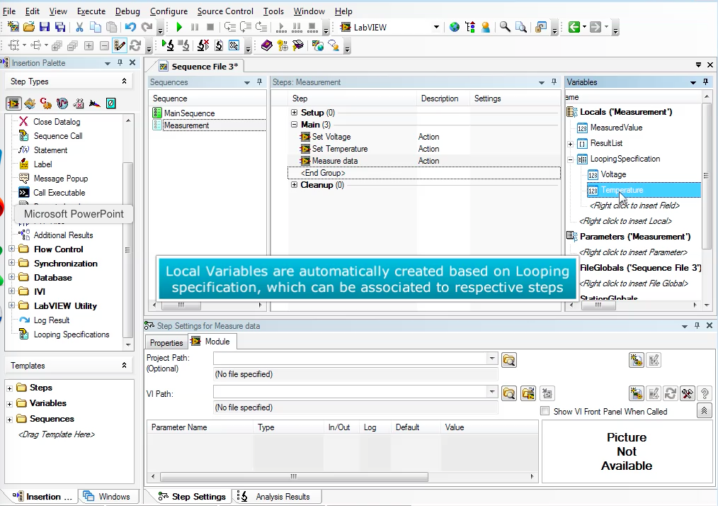
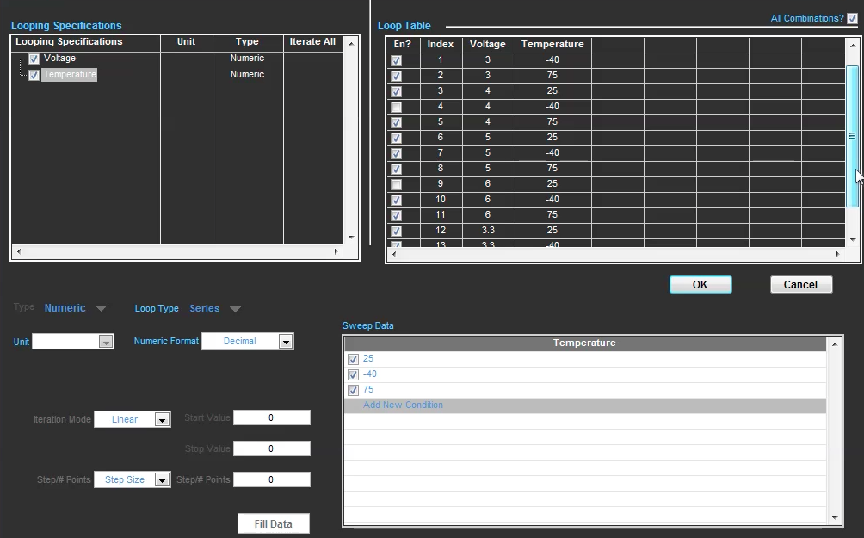
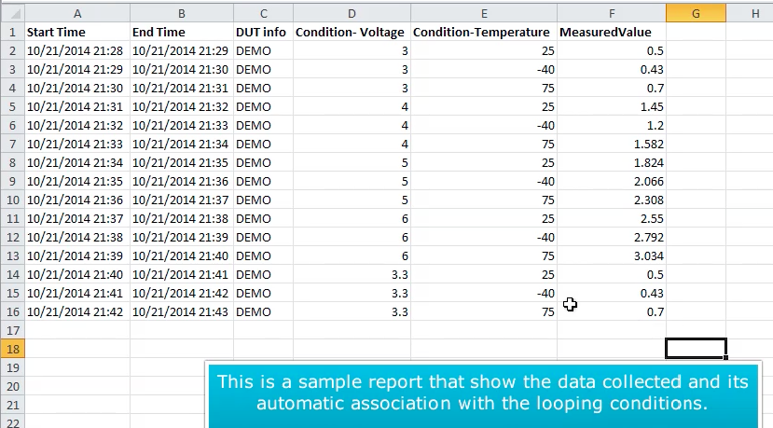
Soliton’s Iteration Tool
Custom Step Type in TestStand
Allows repeated run of sequences across
Multiple test conditions
Combinations of test conditions
Simple GUI for configuration of iteration parameters
Integrated with the Data Logging Tool
Notes:
Picture 1
Describe what kind of looping is required generally in test sequences
Describe how test stand looping will differ from the tool
Picture 2
Describe the various features of the GUI
Combination of iterations
Import Export test conditions
Different types of forcing conditions
Picture 3
Talk about Datalog
Picture 4
1) Report Generation

Slide 5
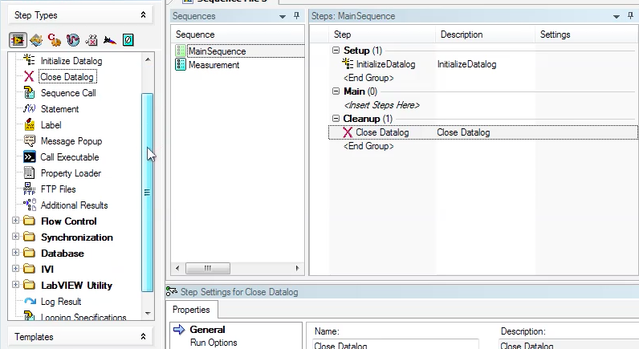
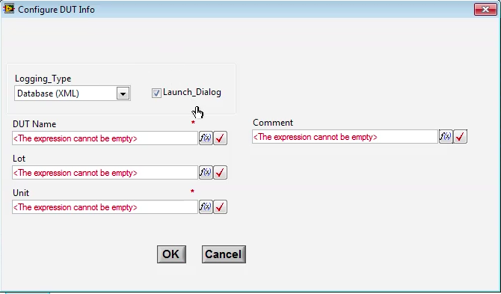
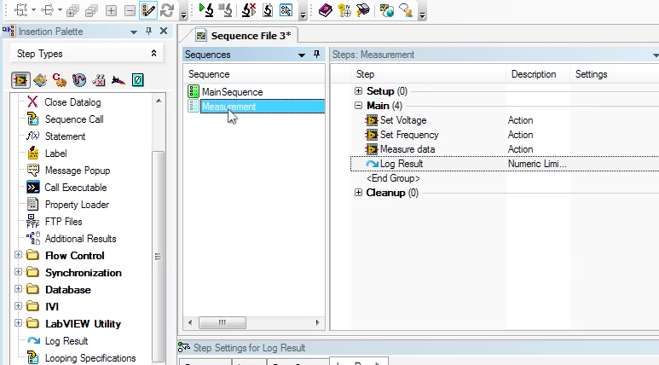
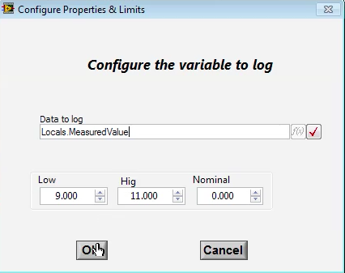
Soliton Custom Data Log Tool
Custom TestStand step
Easily Configurable
Predefined Datalog Format
Database, CSV, ASCII format, etc

Slide 6
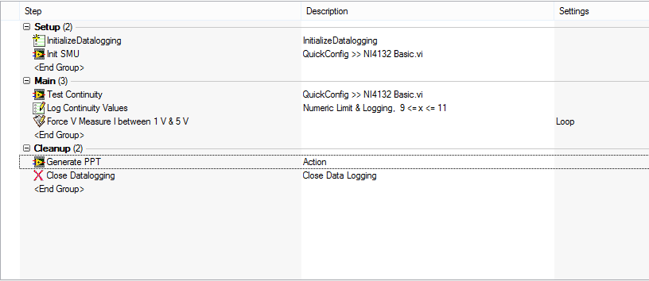
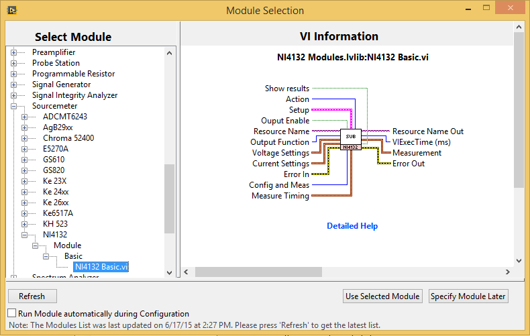
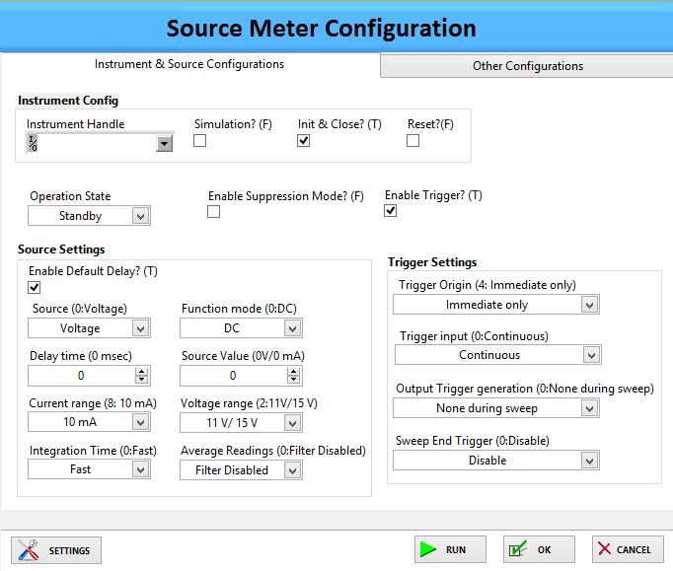
Soliton Instrument Config Tool
Custom TestStand step
Allows to choose from a list of available instruments in Depot
GUI based configuration for each step
Allows user to interchange instruments with minimal effort

Slide 7


Other Soliton Value Tools
Email Notification
Send email notifications at any point in the Test Sequence
Custom Report Generation
Generate Report in required format using Microsoft Office

Slide 8
Questions

